Slide 1

Flood Prediction
A Kaggle based competition By AyUSHI RAJ
Roll. No: 2007499

Slide 2

INTRODUCTION
During my training in Data Analysis and AI/ML at eNest Technologies Pvt. Ltd., I gained hands-on experience in applying advanced machine learning techniques to real-world problems. To showcase my skills, I undertook a Kaggle project focused on flood prediction. This project involved analyzing complex datasets, developing predictive models using algorithms such as CatBoost, XGBoost, and LightGBM, and optimizing these models to improve accuracy. Through this practical experience, I was able to demonstrate my proficiency in data science and machine learning.

Slide 3
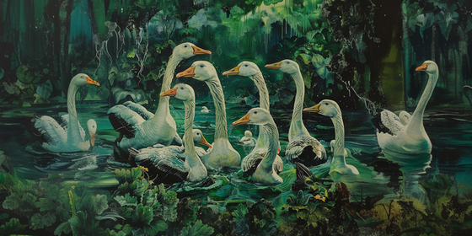
PROBLEM STATEMENT
Flooding is a significant natural disaster that causes extensive damage to infrastructure, disrupts communities, and leads to considerable economic losses. Predicting flood probabilities accurately is crucial for effective disaster management and mitigation strategies. The primary challenge lies in integrating diverse and complex data sources, such as meteorological factors, topographical features, and human activities, to develop a robust predictive model. Our project aims to address this challenge by employing advanced machine learning algorithms to analyze and predict flood probabilities. By leveraging the Kaggle dataset 'Regression with a Flood Prediction Dataset - Playground Series, Season 4, Episode 5', we seek to create a reliable model that can provide timely and accurate flood forecasts, thereby enhancing preparedness and response efforts

Slide 4
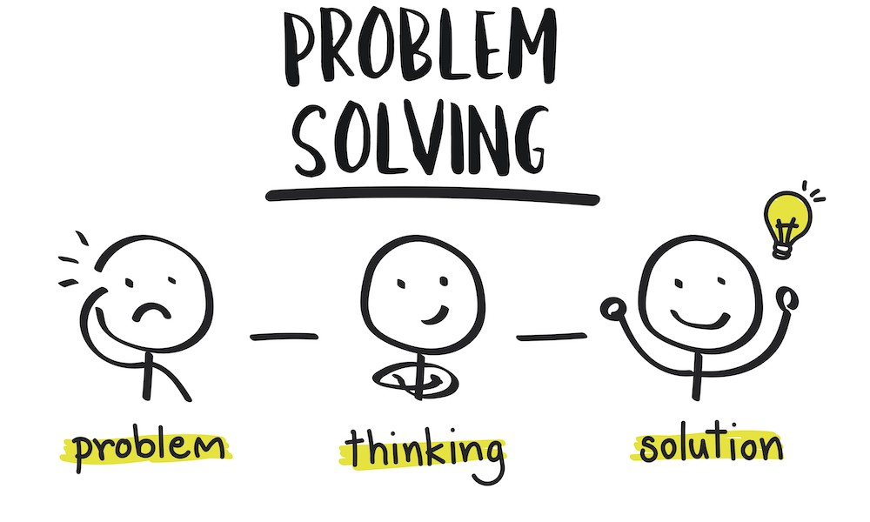
PROBLEM SOLUTION
To address the challenge of accurately predicting flood probabilities, our project employs advanced machine learning algorithms to integrate and analyze diverse data sources, including meteorological factors, topographical features, and human activities. By leveraging the Kaggle dataset 'Regression with a Flood Prediction Dataset - Playground Series, Season 4, Episode 5', we aim to develop a robust predictive model. This model will provide timely and accurate flood forecasts, enhancing disaster preparedness and response efforts. Our approach ensures that communities and infrastructure can be better protected from the adverse impacts of flooding, ultimately reducing economic losses and improving resilience.

Slide 5

APPROACH
Exploratory Data Analysis (EDA): Conducted thorough EDA to uncover patterns and relationships in the dataset, gaining insights into the key factors influencing flood probabilities.
Feature Engineering: Created meaningful features by integrating and transforming data from diverse sources, including meteorological, topographical, and human activities, to better capture the complexities of flood prediction.
Algorithm Testing: Evaluated multiple regression algorithms, such as CatBoost, XGBoost, and LightGBM, to determine their effectiveness in predicting flood probabilities.
Model Evaluation: Assessed the performance of each algorithm using metrics like R-squared, mean squared error, and mean absolute error to identify the most accurate models.
Ensemble Model: Finalized an ensemble model that combines the strengths of the best-performing algorithms, enhancing prediction accuracy and robustness.
Optimization: Continuously fine-tuned the model parameters to ensure optimal performance and reliability in flood forecasting.

Slide 6
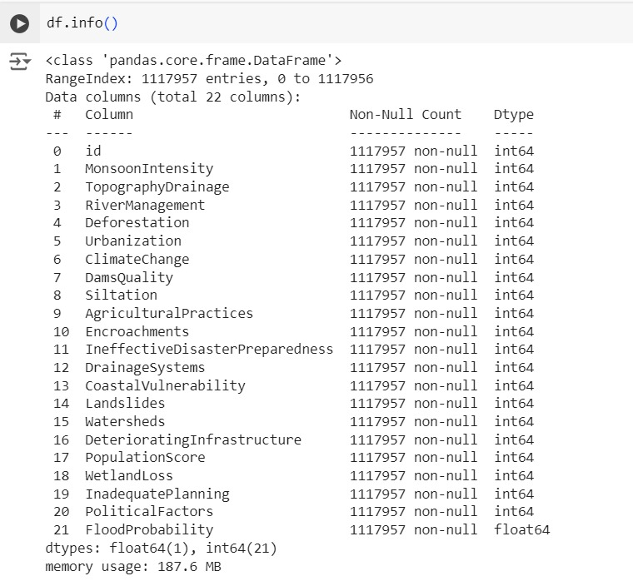
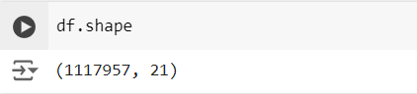
IMPLEMENTATION AND RESULTS
The following code snippet provides names of the columns, the count of non-null values in each column, and the datatype of each column.
~Shape of dataset~
~Information about dataset~

Slide 7
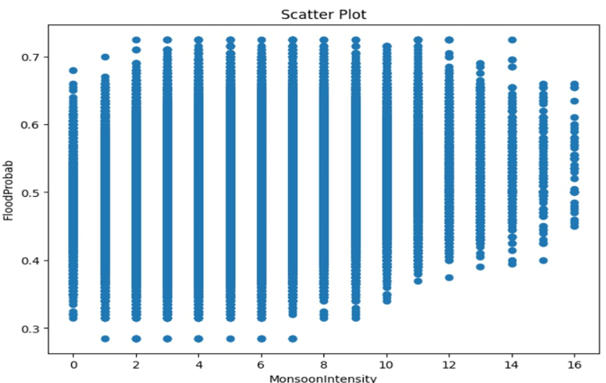
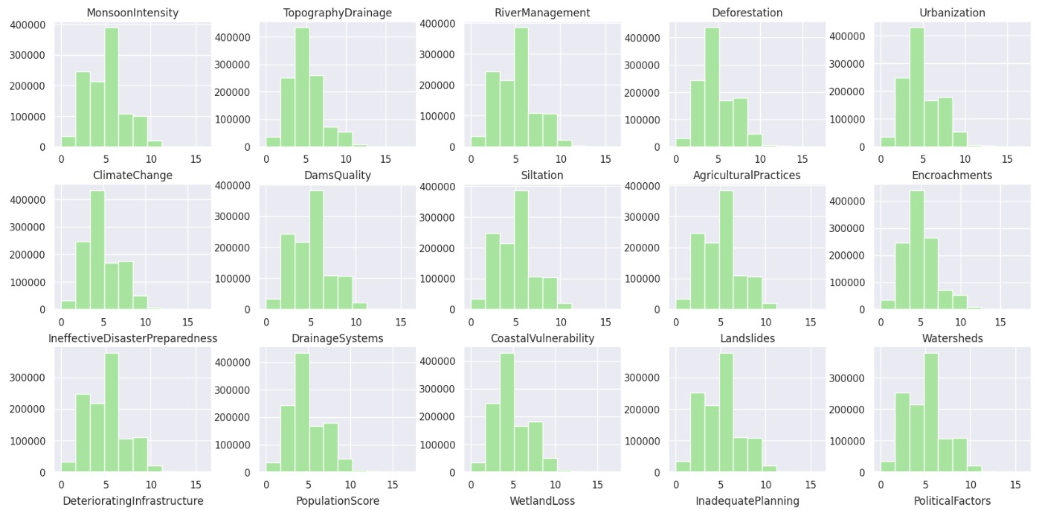
IMPLEMENTATION AND RESULTS…
Following output shows the histogram for each of the predictor variables, and scatterplots(only 2), helps to understand the relation of predictor variables with the target variable, as the predictors are discrete and has a definite range , scatterplots do not capture the exact relation.
~Histogram of each feature~
~Scatterplot of each feature~

Slide 8
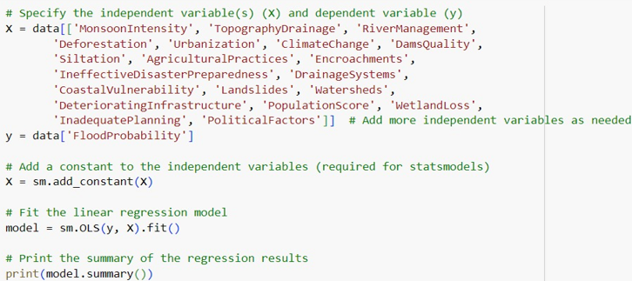
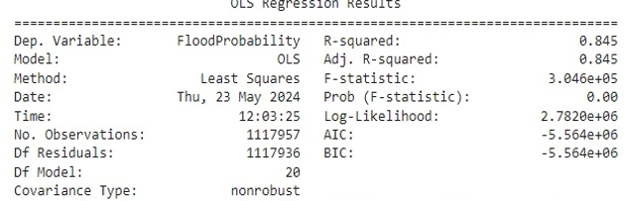
IMPLEMENTATION AND RESULTS…
~Output of Ensemble Model~
~Linear regression Model~

Slide 9
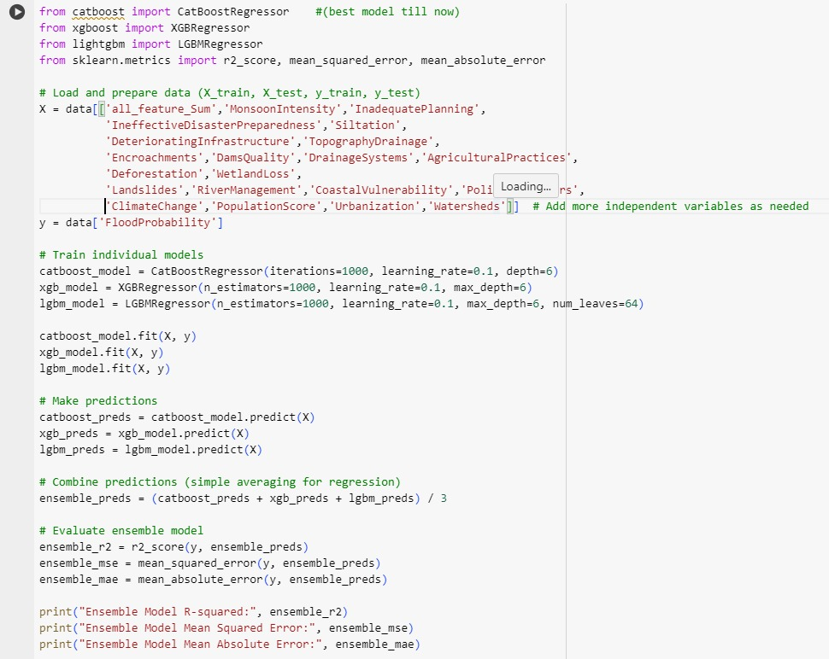
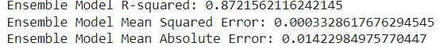
IMPLEMENTATION AND RESULTS…
~Output of Ensemble Model~
~Final Model~

Slide 10
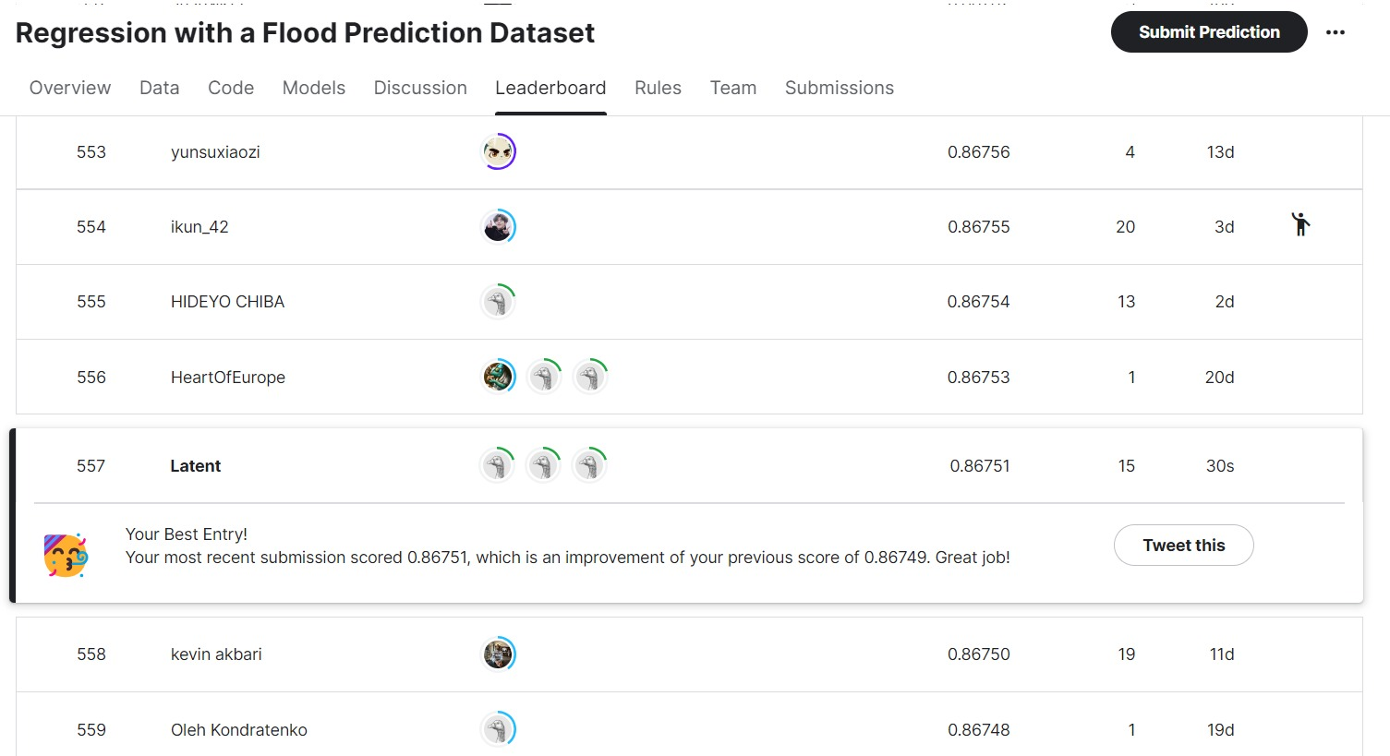
IMPLEMENTATION AND RESULTS…
Leaderboard Position 557/1992

Slide 11

CONCLUSION
The project to predict flood probabilities using advanced machine learning techniques has been a rewarding experience. Leveraging the Kaggle dataset 'Regression with a Flood Prediction Dataset - Playground Series, Season 4, Episode 5', we implemented CatBoost, XGBoost, and LightGBM models to create a high-accuracy ensemble model. Our approach included rigorous feature engineering, model tuning, and validation, leading to robust and reliable predictions. This project showcased our technical proficiency and deepened our understanding of flood prediction dynamics, ultimately achieving a commendable position on the competition leaderboard.

Slide 12

FUTURE SCOPE
The future scope of this project is promising, with numerous avenues for further enhancement. Integrating more diverse datasets, including real-time data from various regions, can improve the model's accuracy. Incorporating additional features such as soil moisture, land use patterns, and real-time weather conditions will provide deeper insights. Applying deep learning techniques like RNNs and CNNs could recognize intricate patterns in the data for even more accurate predictions. Implementing a real-time flood prediction system and exploring explainable AI techniques will increase trust and adoption. Expanding collaborations with disaster management organizations could lead to practical applications, validating and improving our models to mitigate flood impacts effectively.

Slide 13
THANK YOU

